Slide 1
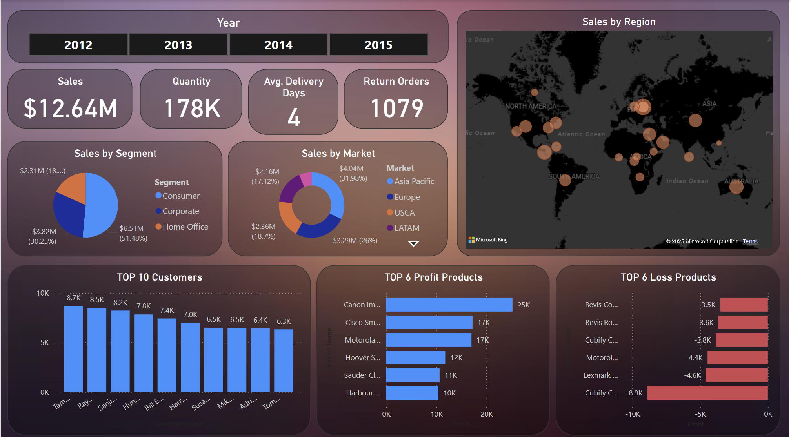
Global Sales Dashboard Summary
By Arun kn

Slide 2
Objective of Dashboard
Empower stakeholders with a dynamic, self-service view of global sales performance at a glance
Uncover key revenue drivers by region, country, product category, and customer segment
Surface profitability insights to optimize pricing, promotions, and resource allocation
Highlight seasonal and trend patterns to inform inventory planning and marketing calendars
Identify underperforming markets and product lines for targeted growth initiatives
Facilitate data-driven decision making through intuitive filters, drill-downs, and cross-visual interactions
Bridge raw transactional data to actionable business recommendations seamlessly

Slide 3
Data Set Overview
Order Date: The date on which the order was placed, used to track sales trends and seasonality over time.
Region: The continent-level area (e.g., Western Europe, Eastern US) where the order was shipped, enabling geographic performance comparison.
Country: The specific nation that received the shipment, allowing for detailed market-level analysis.
Category: The high-level product grouping, showing where revenue is concentrated.
Segment: The customer classification (Consumer, Corporate, or Home Office), highlighting which market segments drive sales and profit.
Quantity: The number of units sold per order, indicating purchase volume and product demand.
Sales: The total revenue generated by each order, reflecting top-line performance.
Profit: The net earnings after costs for each order, measuring overall profitability.

Slide 4
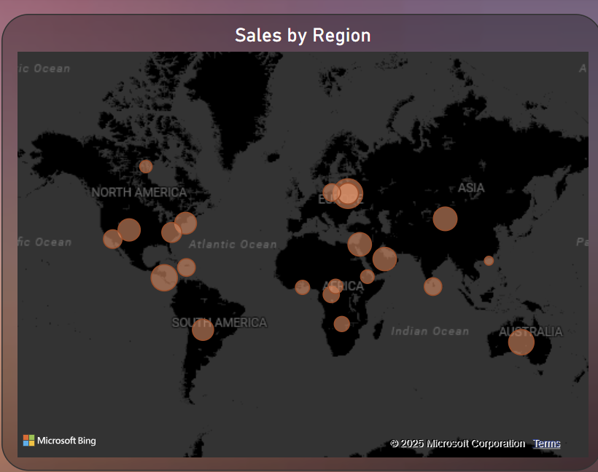
Regional Sales Performance
Western Europe leads with $1.73M in sales
Central America ($1.22M) and Oceania ($1.10M) follow closely
Eastern and Northern Europe show moderate performance
Southern and Central US lag behind compared to other regions
Interpretation: Focus expansion efforts in high-performing regions and investigate underperforming markets for growth.

Slide 5
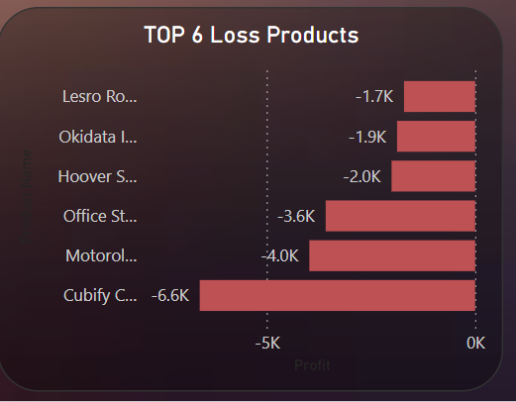
Analysis on the loss products
Cubify Cube 3D Printer (–$6.6K): The largest single loss, suggesting production or procurement costs far exceed revenue.
Motorola XPhone Series (–$4.0K): Significant losses indicate pricing or promotional strategies are too aggressive relative to cost.
Office Star Chairs (–$3.6K): Negative margins point to possible overstock, steep discounting, or high return rates in furniture.
Hoover SteamVac Cleaners (–$2.0K): Small-appliance line underperforming—review warranty costs and servicing expenses.
Okidata ML Printers (–$1.9K): Low-volume, high-cost printers eating into profits; consider raising prices or limiting discounts.
Lesro Roller Chairs (–$1.7K): Entry-level seating products losing money; evaluate supplier terms or streamline SKUs.
Strategic Takeaway: These six products together generate nearly $19.8K in losses. Flag them for urgent pricing review, cost-structure analysis, and potential discontinuation or vendor renegotiation.

Slide 6
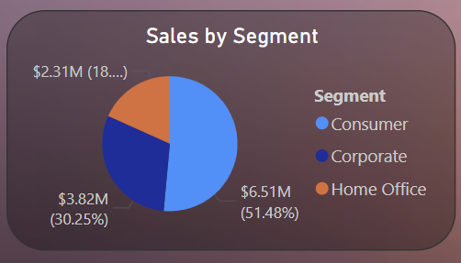
Segment-wise Profitability
Consumer segment dominates the portfolio, accounting for 51.5% of total sales ($6.51 M). This indicates that over half of your revenue is driven by individual end-users and retail-style purchases.
Corporate segment contributes 30.3% of sales ($3.82 M), making it your second-largest revenue stream. Large-account or B2B relationships remain critical—there’s substantial upside in deepening these partnerships.
Home Office accounts for 18.2% of sales ($2.31 M), the smallest of the three. While it’s the least mature segment, it still represents nearly one-fifth of revenue, suggesting room to grow through targeted small-business offerings or bundled solutions.
Strategic takeaway: Prioritize investments and promotions in the Consumer segment to protect your core, while designing bespoke engagement and upsell programs for Corporate clients. Simultaneously, explore tailored product bundles or marketing initiatives to accelerate Home Office growth.

Slide 7
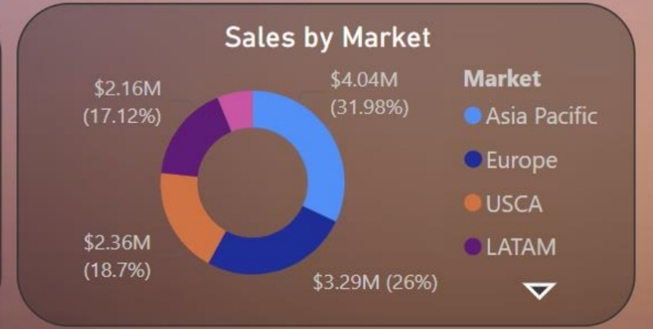
Sales by Market performance
Canon ImageCLASS Printer: Highest profit generator—high margin and strong sales volume.
Apple iPhone: Premium pricing and strong demand make it a top profit driver.
Cisco Equipment: Reliable office tech with consistent, high-margin sales.
Canon PIXMA Printers: Cost-effective printers delivering strong profitability.
Logitech Accessories: Popular peripherals contributing steady profits.
Samsung Galaxy Devices: Strong brand presence ensures profitable sales.

Slide 8
